Slide 1

Parts of Speech
All About
Adjectives

Slide 2
Adjectives
An adjective is a part of speech that describes or modifies a noun or pronoun in a sentence.
Examples:
She has golden hair.
There are twelve eggs in a carton.
I want to buy that dress.

Slide 3
Adjectives
There are several kinds of adjectives:
Articles as adjectives
Descriptive adjectives
Demonstrative adjectives
Interrogative adjectives
Comparative adjectives
Superlative adjectives
Coordinate adjectives
Non-coordinate adjectives

Slide 4
Adjectives
Adjectives answer these questions.
What kind is it?
It is the blue kind.
It is the shiny one.
How many are there?
There are four quarters in a dollar.
She bought two new notebooks.
Which one is it?
It is that one.
It is the new one.

Slide 5
Articles as Adjectives
The articles a, an, and the are adjectives
Examples:
A dog sat in the corner.
Jen’s squirrel ate an acorn.

Slide 6
Descriptive Adjectives
A descriptive adjective describes a noun. It can describe its quantity, quality, color, size, etc.
Examples:
She has three balloons.
The red balloons are for the party.
There are many balloons that are overfilled.
That is an amazing balloon.

Slide 7
Demonstrative Adjectives
Demonstrative adjectives are used to indicate or point out a noun or pronoun.
The four demonstrative adjectives are: this, that, these, and those.
Examples:
She wants those shoes.
That pencil belongs to the teacher.
These essays need to be graded.
You should sing this song tonight.

Slide 8
Interrogative Adjectives
Interrogative adjectives are used to ask questions about nouns.
The four interrogative adjectives are: where, what, which, and whose.
Examples:
Where are my shoes?
What movie do you want to see?
Which hot sauce is your favorite?
Whose car is this?

Slide 9
Comparative Adjectives
A comparative adjective is an adjective that is used to compare two nouns or pronouns to each other.
Comparative adjectives typically end in –er
Examples:
stronger
faster
wiser
*more fun
*Some comparative adjectives are irregular and do not follow this pattern.

Slide 10
Superlative Adjectives
A superlative adjective is used to show superiority between three or more nouns or pronouns.
Superlative adjectives usually end in –est
Examples:
strongest
fastest
wisest
*most fun
*Some superlative adjectives are irregular and do not follow this pattern.

Slide 11
Comparative/Superlative
The chart below shows the relationship between adjectives and their comparative and superlative forms.
Adjective | Comparative | Superlative
large | larger | largest
sad | sadder | saddest
dry | drier | driest
quick | quicker | quickest
tiny | tinier | tiniest
simple | simpler | simplest
important | more important | most important
many | more | most
good | better | best

Slide 12
Coordinate Adjectives
Coordinate adjectives are adjectives that can be rearranged and switched and still make sense.
Use a comma between coordinate adjectives.
Examples:
The friendly, brown dog smiled at us.
The brown, friendly dog smiled at us.

Slide 13
Non-coordinate Adjectives
Non-coordinate adjectives are adjectives that cannot be switched or rearranged.
Do not use commas to separate non-coordinate adjectives.
Examples:
Fido went into his green dog house.
Fido went into his dog green house.

Slide 14
Coordinate vs. Non-Coordinate
Coordinate
Non-coordinate
Use a comma
The girl wore a frilly, blue dress.
The girl wore a blue, frilly dress.
The radio played a cheerful, upbeat song.
The radio played an upbeat, cheerful song.
Do not use a comma
We drove on a long dirt road.
We drove on a dirt long road.
The strong tropical storm wrecked the building.
The tropical strong storm wrecked the building.
Notice: The sentences with the strikethrough do not make sense!
It is okay to change “a” to “an.”

Slide 15
Adjectives
Why do we use adjectives?
We use adjectives in our writing to help add description and variety. Adjectives help us be more specific and convey our message accurately.

Slide 16
Adjectives
Read how the adjectives enhance these sentences.
I bought a shirt.
The Wilson family adopted a dog.
I bought a yellow, striped shirt.
The caring Wilson family adopted a small, brown and white dog.

Slide 17
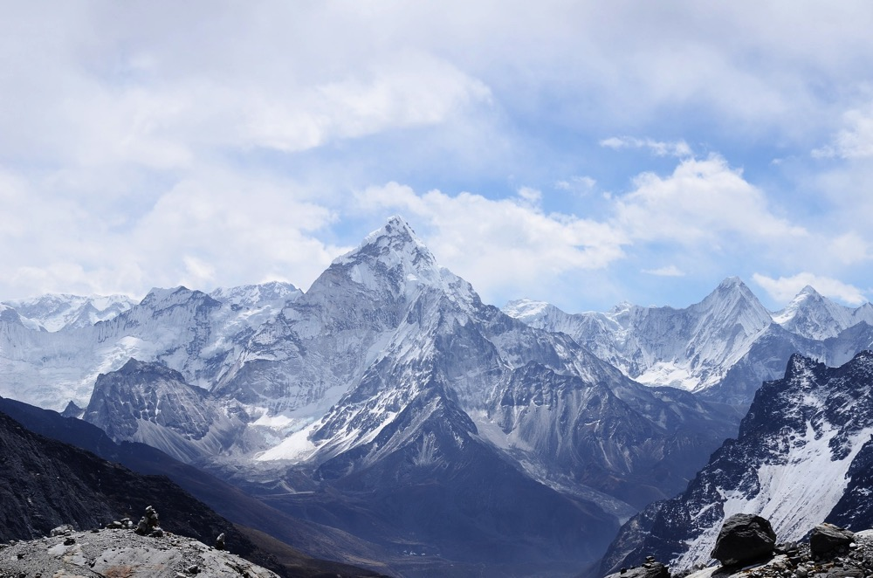
Write Some Adjectives
Write a list of adjectives that you can use to describe this image.
Can you label each type of adjective you wrote?

Slide 18
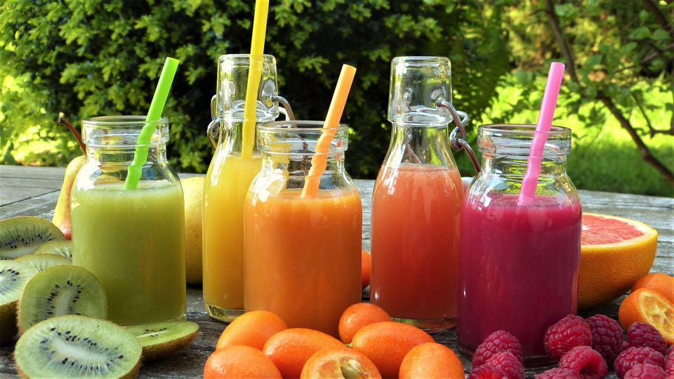
Write Some Adjectives
Write a list of adjectives that you can use to describe this image.
Can you label each type of adjective you wrote?

Slide 19
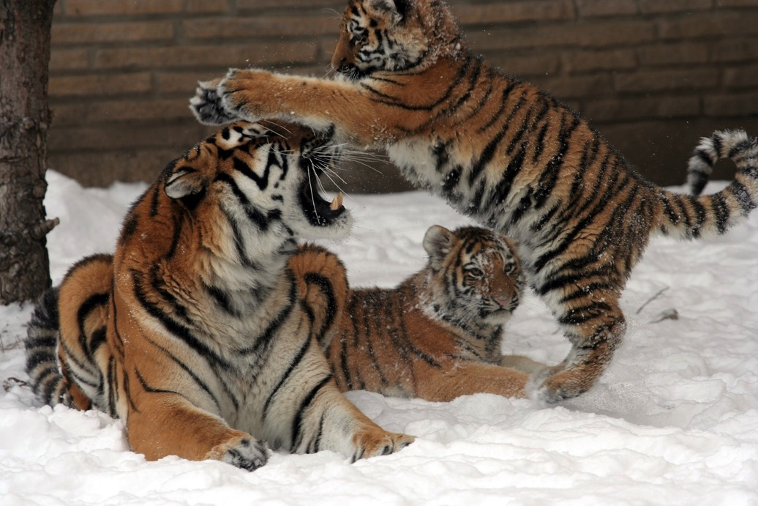
Write Some Adjectives
Write a list of adjectives that you can use to describe this image.
Can you label each type of adjective you wrote?

Slide 20
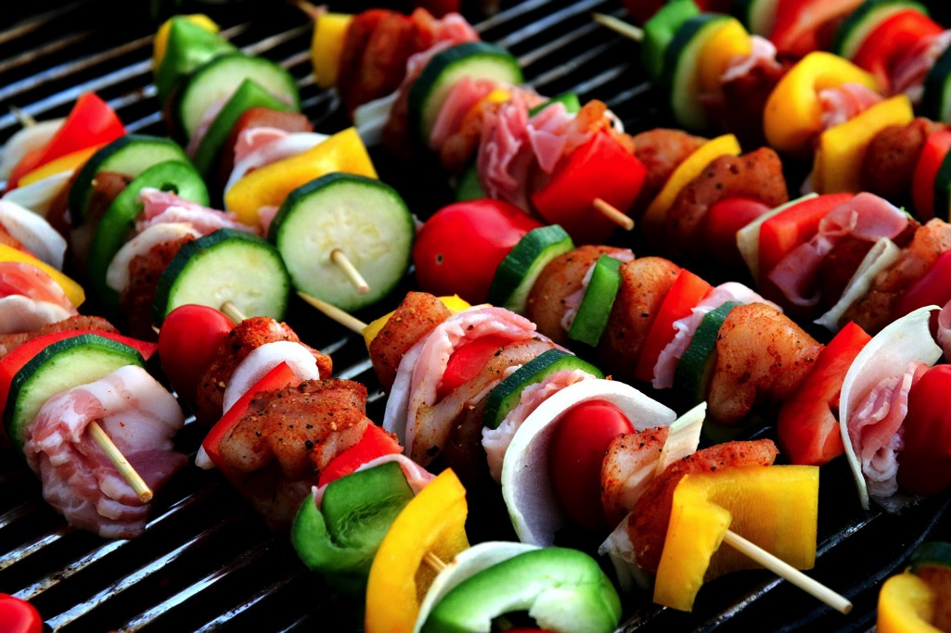
Write Some Adjectives
Write a list of adjectives that you can use to describe this image.
Can you label each type of adjective you wrote?

Slide 21
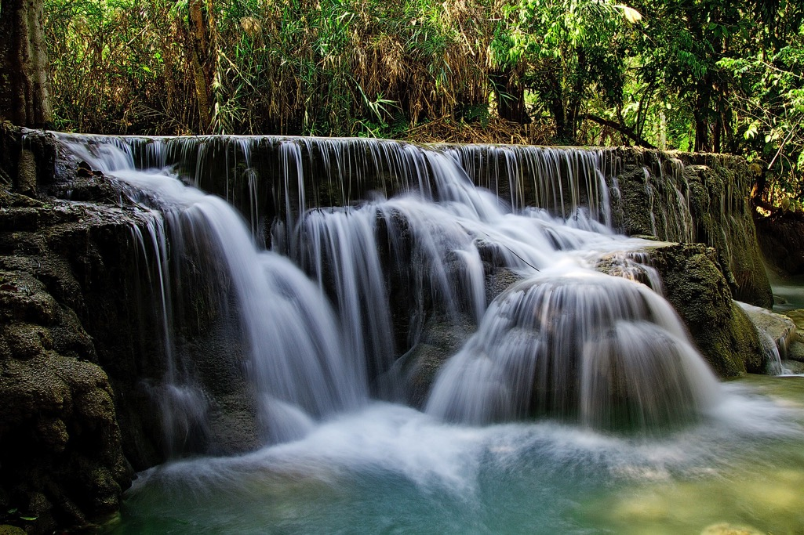
Write Some Adjectives
Write a list of adjectives that you can use to describe this image.
Can you label each type of adjective you wrote?

Slide 22
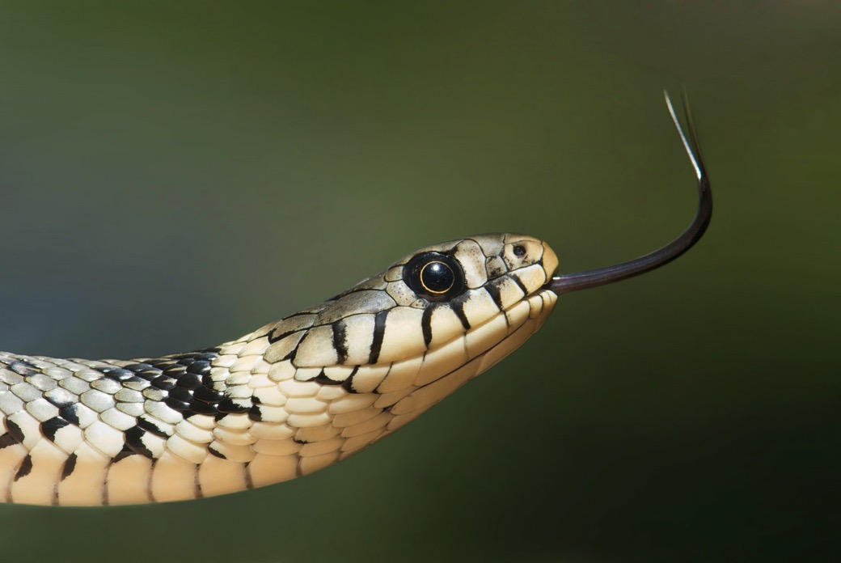
Write Some Adjectives
Write a list of adjectives that you can use to describe this image.
Can you label each type of adjective you wrote?

Slide 23
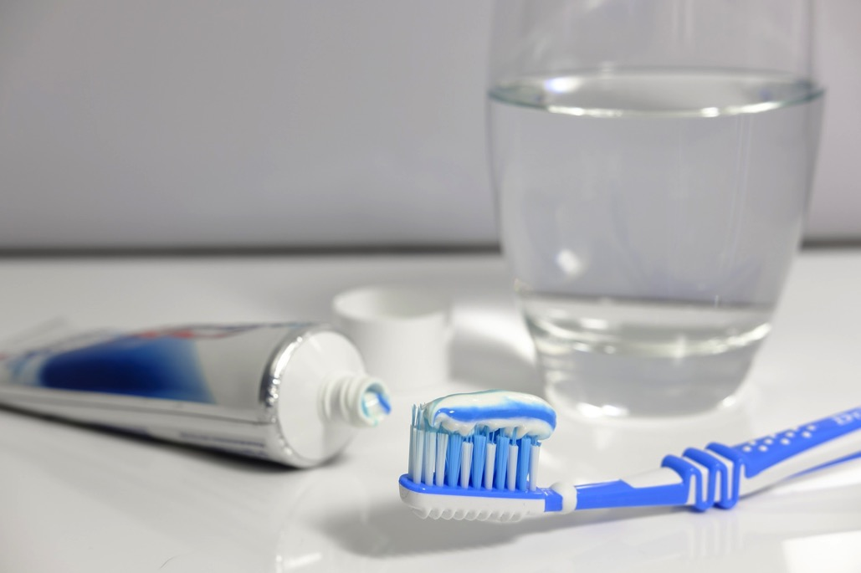
Write Some Adjectives
Write a list of adjectives that you can use to describe this image.
Can you label each type of adjective you wrote?

